Slide 1

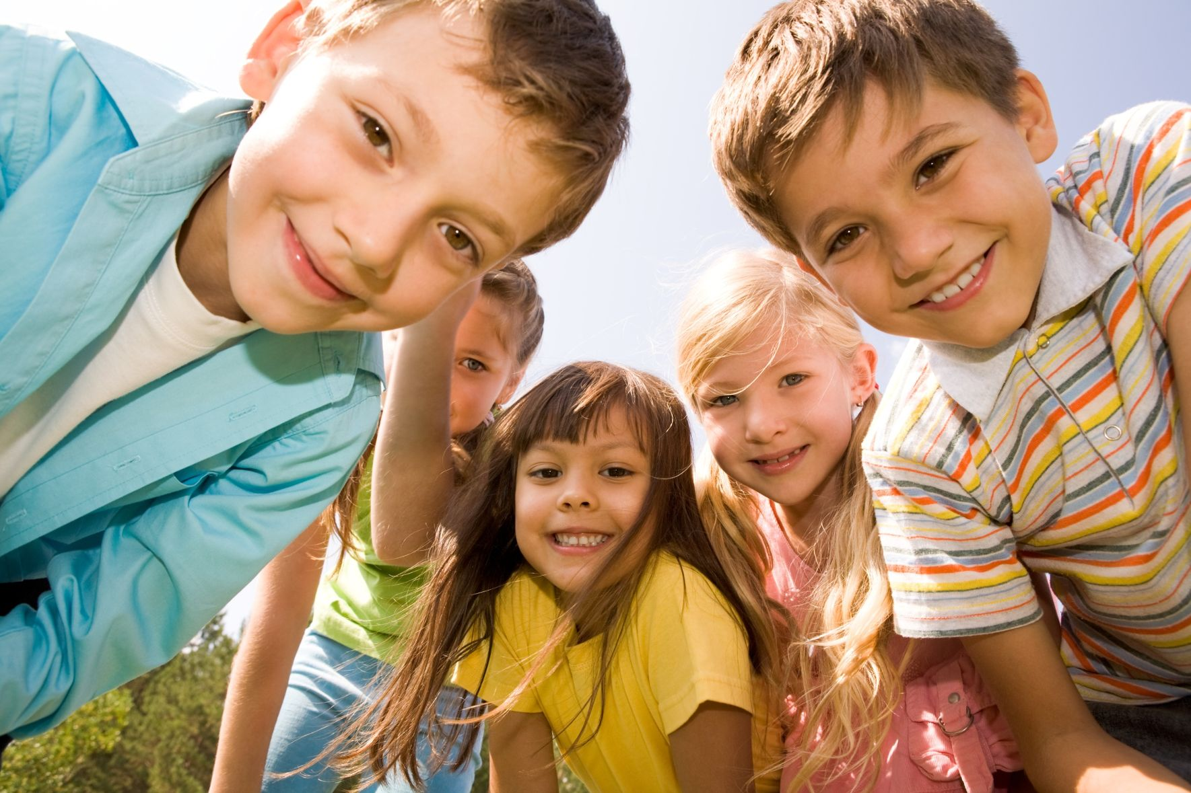
Are you a healthy kid?

Slide 3
Check yourself
0. You’ve hurt your leg. You must visit a surgeon.
1. I feel tired. Shall I consult a doctor?
2. If a child has got a cold, he/she mustn’t take aspirin.
3. If you’ve got the flu, you must consult the pediatrician.
4. If you’ve got backache, you shouldn’t carry heavy things.
5. “I’ve got toothache.” – “Shall I take you to a dentist?”
6. My cat has got a stomachache. I must take it to a vet.
7. If you’ve got appendicitis, you must stay at home.

Slide 4
Give the Russian equivalents:
A healthy mind in a healthy body.
Wealth is nothing without health.
An apple a day keeps a doctor away.
Кто яблоко в день съедает, у того доктор не бывает.
Здоровье дороже денег.
В здоровом теле здоровый дух.

Slide 5

Pass this “magic apple”
to your friend
with good words
to him/her.
I wish you to be happy
I wish you to be healthy
I wish you to be kind
I wish you to be hardworking
I wish you to be brave
I wish you to do well

Slide 6
Thank you for your
good work!

